Slide 1
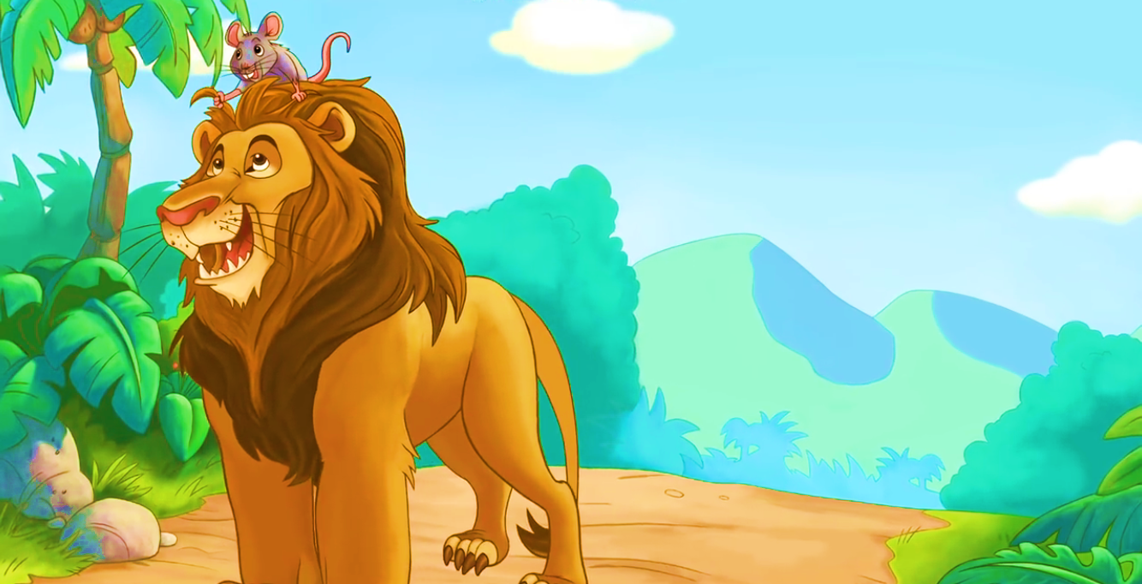
The Lion and The Mouse
Presented by:
Muhammad Owais

Slide 2

Once there lived a lion in a jungle

Slide 3


One day, tiny Jerry accidentally woke him

Slide 4
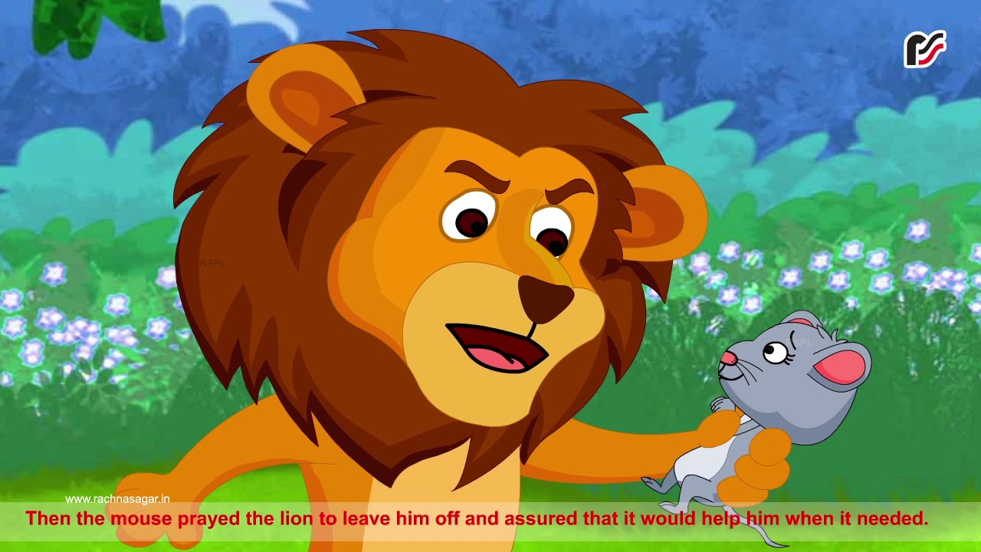
Leo spared her but asked for a promise.
Please Forgive me!

Slide 5
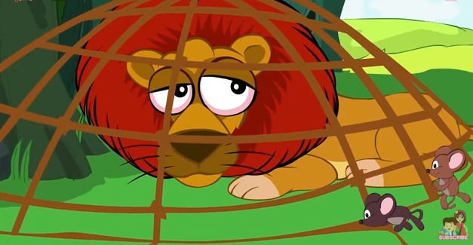
Later, Leo got trapped in a net, and Mia, remembering her promise, rushed to help. She nibbled the net's ropes and set him free.

Slide 6

Leo thanked her and they became best friends, having more adventures together.

Slide 7
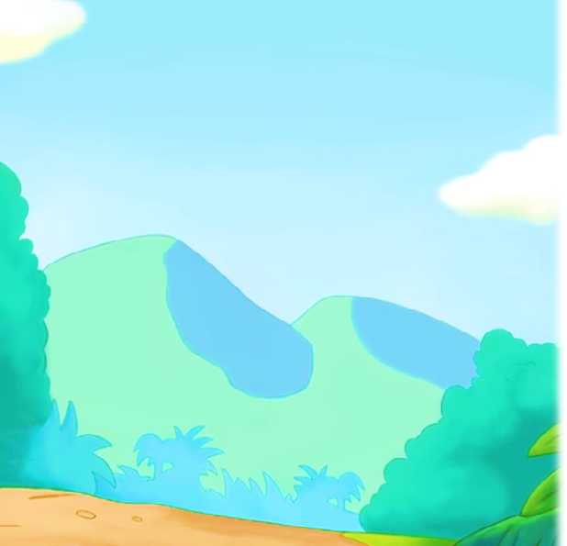
Moral:
an act of kindness never goes unrewarded

